Slide 1
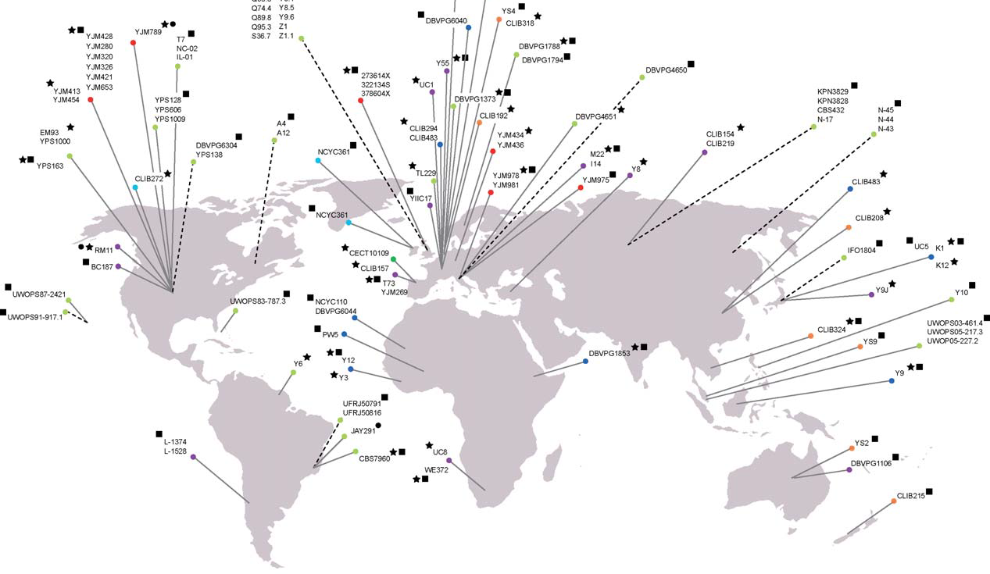


Lifespan and healthspan measures in wild-derived and laboratory diploid Saccharomyces cerevisiae
Kaeberlein lab meeting
Mitchell Lee – Kaeberlein Lab
11-07-2014

Slide 2
SGRP: Saccharomyces Genome Resequencing project – Collection of Saccharomyces strains derived from multiple sources (ecotypes) used to evaluate genomic variation within the Saccharomyces Genus.
NCYC: National Collection of Yeast Cultures – UK strain repository

Slide 3
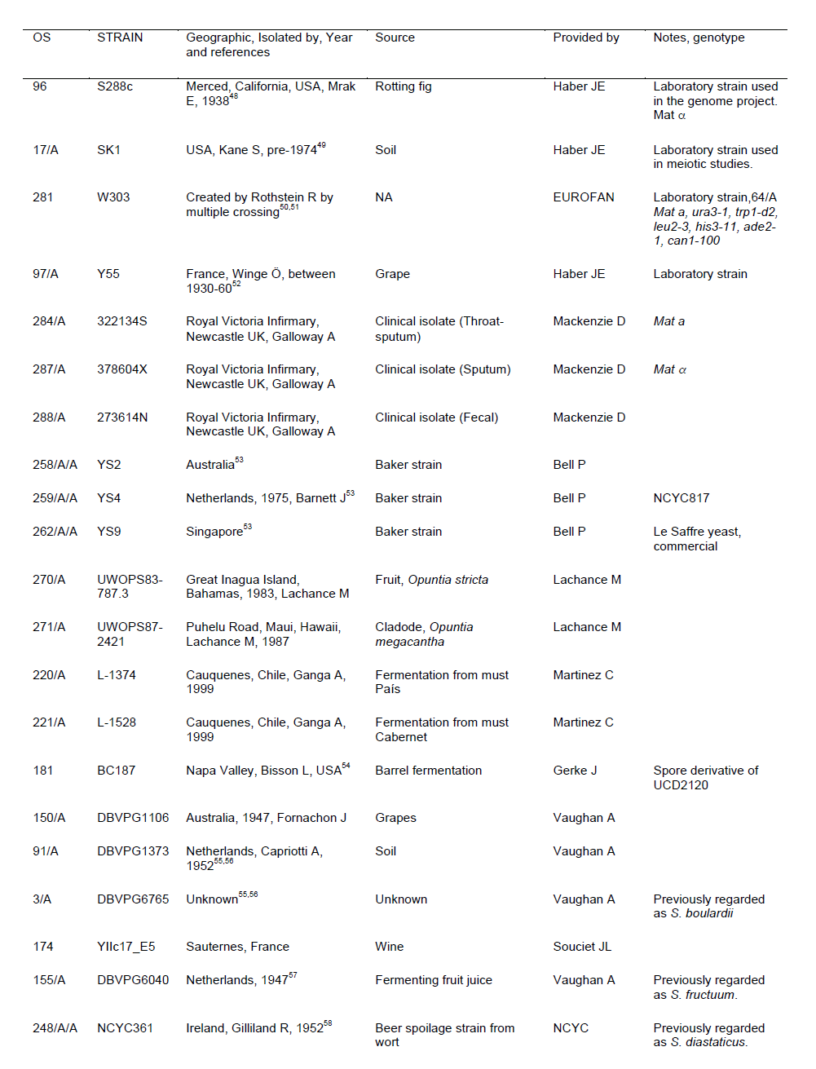
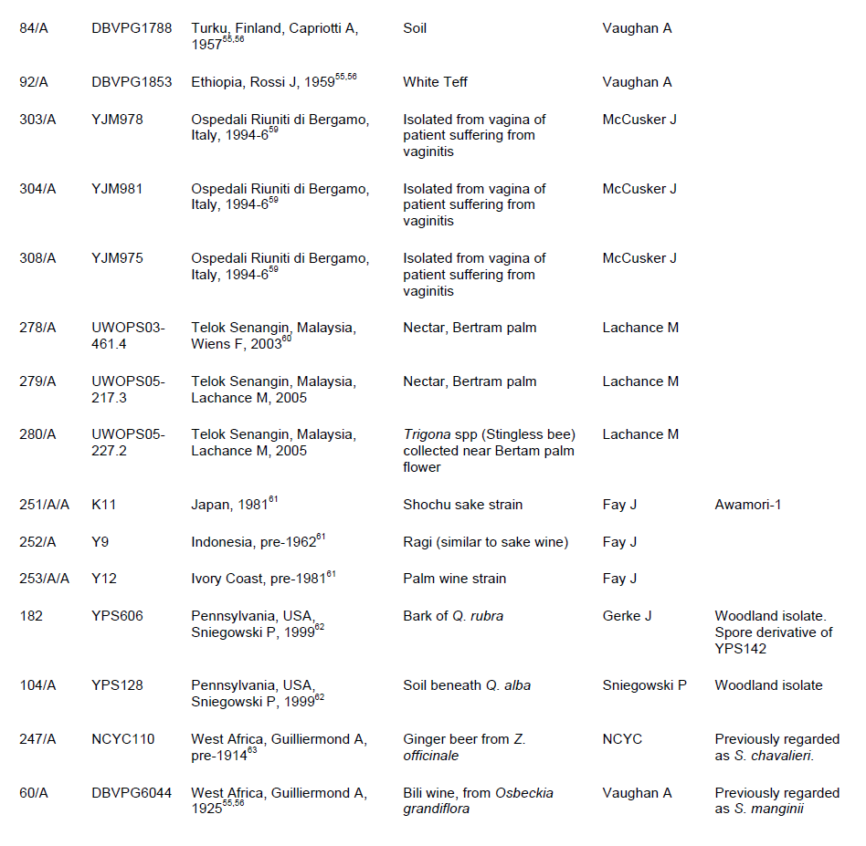
What are the SGRP strains?
Liti et al., 2009

Slide 4
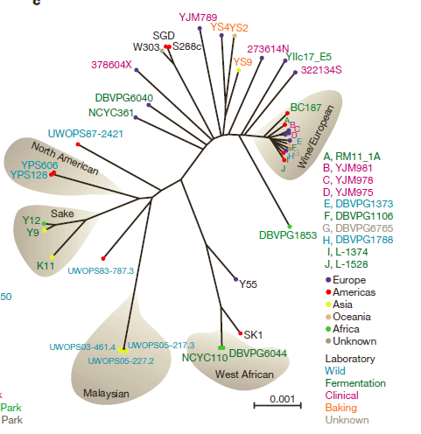
What are the SGRP strains?
Ecotype | Number of Strains
Baking | 3
Clinical | 6
Fermentation | 13
Laboratory | 5*
Unknown | 1
Wild | 9
 | 37
*BY4743 included
Liti et al., 2009

Slide 6
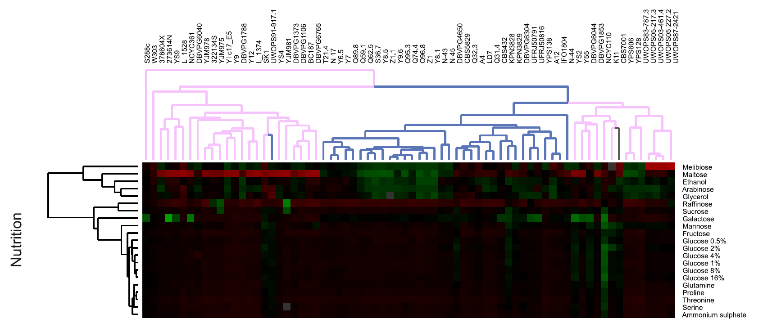
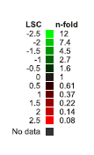
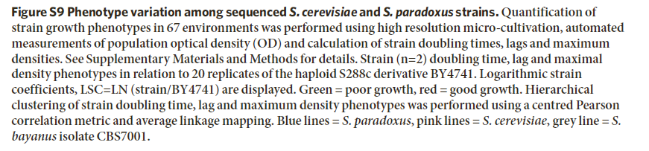
Liti et al., 2009

Slide 7
Colllaboration with Alaattin Kaya
Perform RLS, CLS, and various healthspan measures (bioscreen) using strains from the SGRP
Separate strains based on lifespan/healthspan measures
Use sequencing information available from SGRP to identify novel SNPs (or larger genomic changes) that segregate with lifespan/healthspan changes
For bioscreen assays, 2% glucose (standard conditions) and 3% glycerol (respiratory induction)

Slide 8
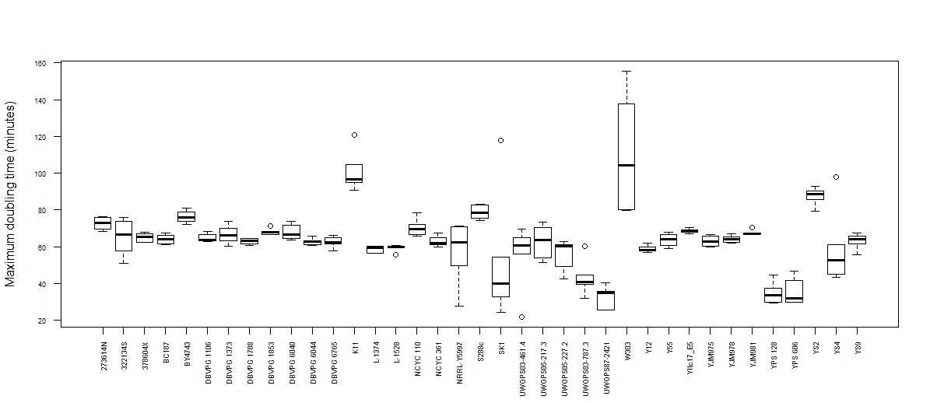
Wild isolate yeast show a large range of maximum doubling times
Interestingly, the majority of lab strains show some of the slowest maximum doubling times
Some strains show reproducibly fast maximum doubling times
Are there commonalities?
o/n YPD culture
2µls o/n into 148µls YPD
N=6-12 for each strain
Max doubling time =inflection method

Slide 9
Fastest growing strains are true wild isolates from the Americas and are phylogenetically closely related
YPS128 is among the strains genetically engineered for transgenic construction

Slide 10
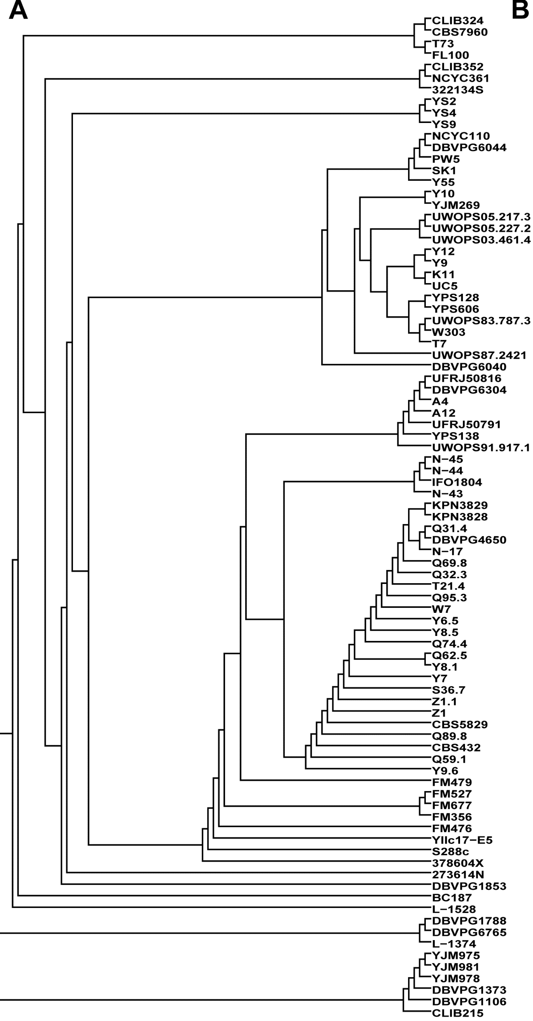
Phylogenic relationships are well-established among diverse yeast
Expanded phylogeny courtesy Alaattin Kaya
Liti et al., 2009

Slide 11
Sequence diversity of TOR1 in wild yeast reveal four broad clusters
TOR1 phylogeny courtesy of Alaattin Kaya

Slide 12
Bioscreen-based growth analysis provides a high-precision means of assaying microbial outgrowth
Respiratory metabolism
Fermentative metabolism
Diauxic shift
Maximal doubling time
(minutes/cell division)
Media = YPD

Slide 13
Resistance and/or sensitivity being tested among wild isolate yeast to explore natural diversity of mTOR signaling
Vehicle | Treatment | minimum number of experiments/treatment*
1% DMSO | 2.5 ng/mL Rapamycin | 4
1% DMSO | 20 ng/mL Rapamycin | 4
2.5% DMSO | 1 µM Torin 1 | 4
2.5% DMSO | 25 µM Torin 1 | 4
2.5% DMSO | 100 µM GDC-0941 | 4
2.5% DMSO | 100 µM AZD8055 | 4
6.67% H2O | 1000 µg/mL Caffeine | 4
 | Total experiments | 28
 |  | *test up to 23 strains + BY4743/experiment
Initial set of experiments completed

Slide 14
48 hour yeast growth in rich liquid media shows respiratory shift in metabolism
Respiratory metabolism
Stationary phase
Diauxic shift
Exponential phase (fermentative metabolism)
Each unit = 30 minutes

